Slide 1
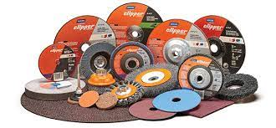
Demand Forecasting
For Industrial Products
Presentation by:
Aditi Kannan
SSN College of Engineering

Slide 2
Objective/Motivation
Any organization/industry faces several internal and external risks. The adverse effects of risks can be lessened by determining the demand or sales prospects for its products and services in future.
“Demand estimation (forecasting) may be defined as a process of finding values for demand in future time periods.”
Notes:
Student Notes:
The objective of the session is to introduce the concept of time varying signals and how these signals are described and classified further. We will also discuss various types of other classifications with examples.

Slide 3
Literature Review
Author | Title of the paper | Conference/ Journal Publication | Description
Bontempi, G., Taieb, S. and Borgne, Y. | Machine Learning Strategies for Time Series Forecasting | Lecture Notes in Informatics (LNI) - Proceedings Series of the Gesellschaft für Informatik (GI) Volume P-295 ISBN 978-3-88579-689-3 ISSN 1617-5468 | Review of machine learning techniques in time series forecasting
Mehrmolaei, S. and Keyvanpour, M. R. | Time series forecasting using improved ARIMA | 2016 Artificial Intelligence and Robotics (IRANOPEN), Qazvin, Iran | The authors propose a novel approach to improve ARIMA model by applying a mean of estimation error for time series forecasting. Experimental results indicate that the proposed approach can improve performance in the process of time series data.
Siami-Namini, S., Tavakoli, N. and Siami Namin, A | A Comparison of ARIMA and LSTM in Forecasting Time Series | 2018 17th IEEE International Conference on Machine Learning and Applications (ICMLA), Orlando, FL, USA | The authors investigate the superiority of deep learning-based algorithms for forecasting time series data, such as "Long Short-Term Memory (LSTM)", to the traditional algorithms.
Wanchoo, K. | Retail Demand Forecasting: a Comparison between Deep Neural Network and Gradient Boosting Method for Univariate Time Series | 2019 IEEE 5th International Conference for Convergence in Technology (I2CT), Bombay, India | The author implemented two machine learning techniques, Deep Neural Network (DNN) and Gradient Boosting Method (GBM) for univariate time series sales data at store-day level of a German retail giant
Bandara, K., Shi, P., Bergmeir, C., Hewamalage, H., Tran, Q. and Seaman, B. | Sales demand forecast in e-commerce using a long short-term memory neural network methodology | Neural Information Processing: 26th International Conference, ICONIP 2019, Sydney, NSW, Australia | The authors attempt a model which conditions the forecast of an individual time series on past behaviour of similar, related time series. This is achieved by globally training a Long Short-Term Memory network (LSTM) that exploits the nonlinear demand relationships available in an E-commerce product assortment hierarchy
Notes:
Student Notes:
The objective of the session is to introduce the concept of time varying signals and how these signals are described and classified further. We will also discuss various types of other classifications with examples.

Slide 4
Forecasting System
Input Data:
Abrasives Demand
IIP Data
Special Discount Rate
Data Pre-
Processing:
Stationarity
Homogeneity
Randomness
Treatment for Outliers
Imputation of Missing Data
Forecast Model
Training/Validation
ARIMAX
LSTM
Demand Forecast
Prediction Results
Analysis and Conclusion

Slide 5
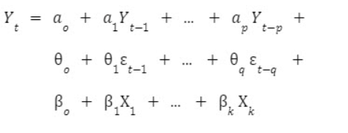
ARIMAX Model
Linear regression equation for ARIMAX :
Y_{t} is the dependent variable at time t.
a₁ to a_{p} are the autoregressive coefficients of order p.
θ₁ to θ_{q} are the moving average coefficients of order q.
ε_{t-1} to ε_{t-q} are the first q moving average terms
β represents the differencing coefficients

Slide 6
ARIMAX Model
The autoregressive part (AR) forecasts the variable of interest by using the past values of the variable
The integrated part (I) represents the differencing of raw observations to allow the time series to become stationary.
The moving average part (MA) uses past forecast errors in a regression-like model. The past forecast error is the difference between the actual data and fitted values

Slide 7
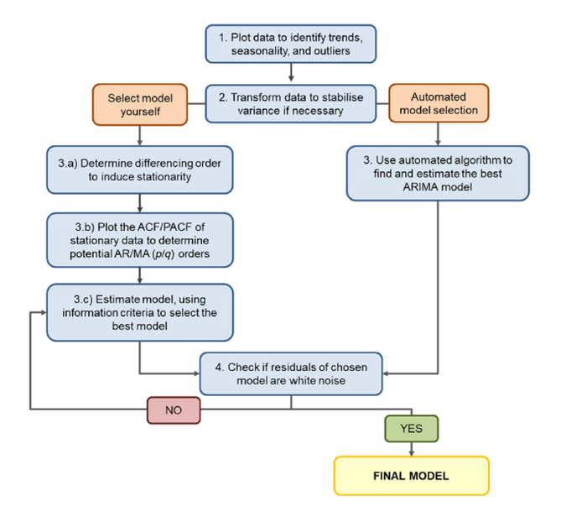

ARIMA Model Selection
Let B(x_{t})=x_{t−1} denote the lag operator.
Let us define z_{t}=y_{t}−y_{t−1} as the response.
The ARIMA (2,1,1) can be defined as

Slide 8
LSTM Model
LSTMs work by maintaining a cell state that can store information over time, selectively updating and resetting the cell state based on input data. The cell state is controlled by gates, which are a set of sigmoid neural network layers that decide how much information to keep, how much to forget, and how much to output at each time step.
LSTM architecture consists of four main components: the input gate, the forget gate, the output gate, and the cell state
Input gate: Determines how much of the input should be added to the cell state.
Forget gate: Determines how much of the previous cell state should be forgotten.
Output gate: Determines how much of the cell state should be output.
Cell state: The memory of the LSTM that stores information over time.

Slide 9
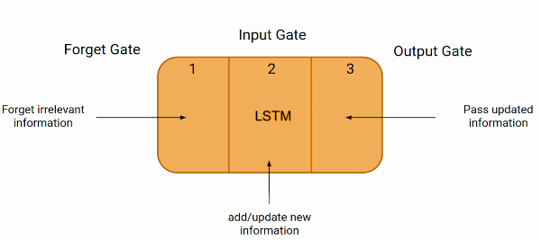
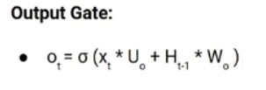


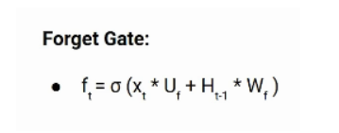
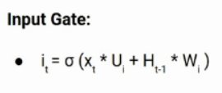
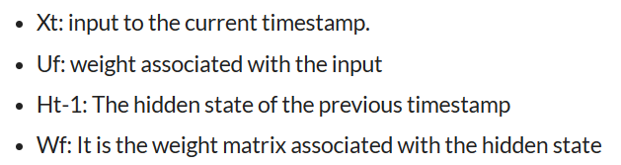
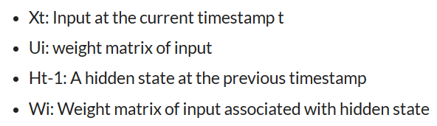
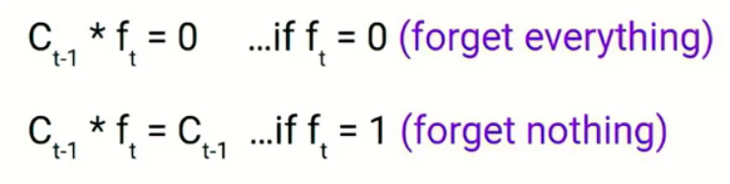

LSTM Model

Slide 10
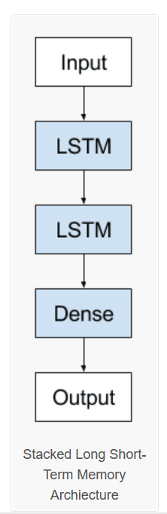
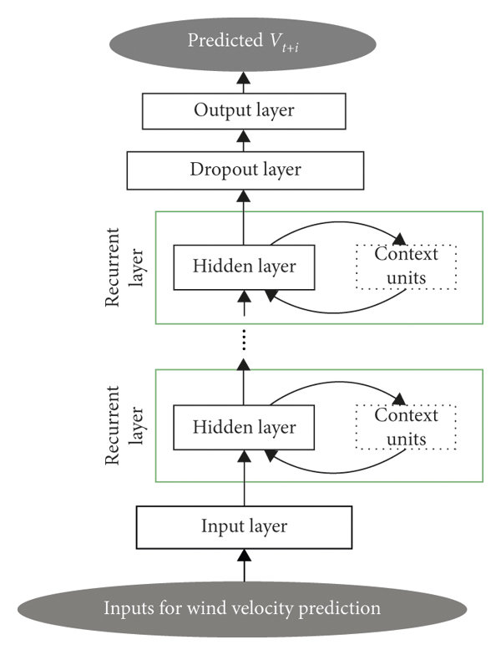
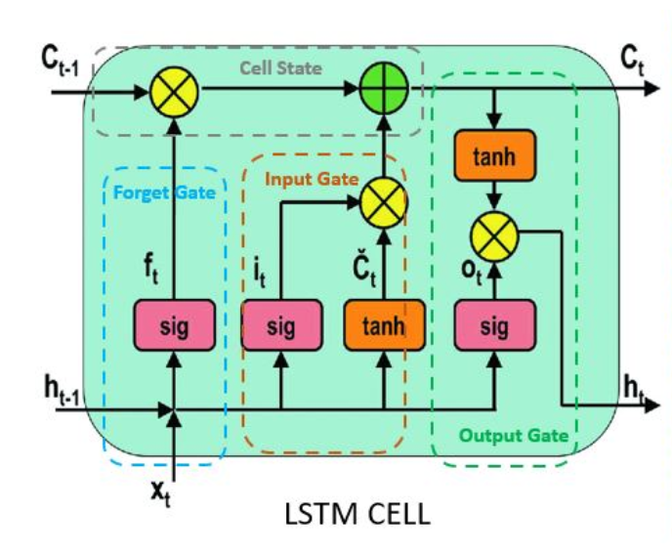
LSTM Model
Predicted D_{t+1}
Number of Hidden Layers : 100
Dense Layer : 1
Loss Function : MAE
Optimizer : Adam
Input for Demand prediction

Slide 11
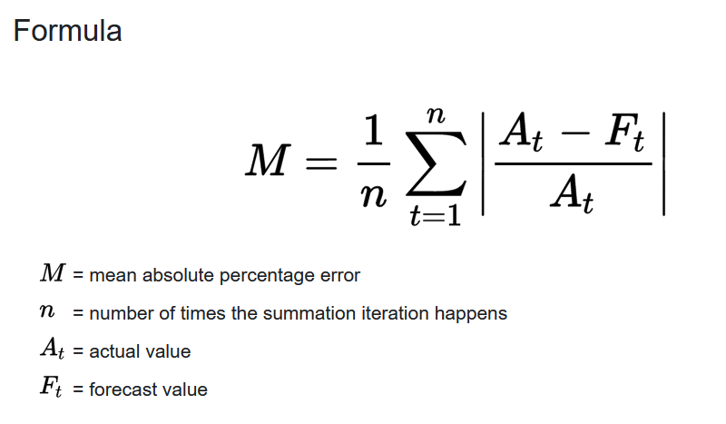
Performance Metrics
Mean Absolute Percentage Error
MAPE | Interpretation
< 10% | Very Good
10% - 20% | Good
20% - 50% | OK
> 50% | Not Good

Slide 12
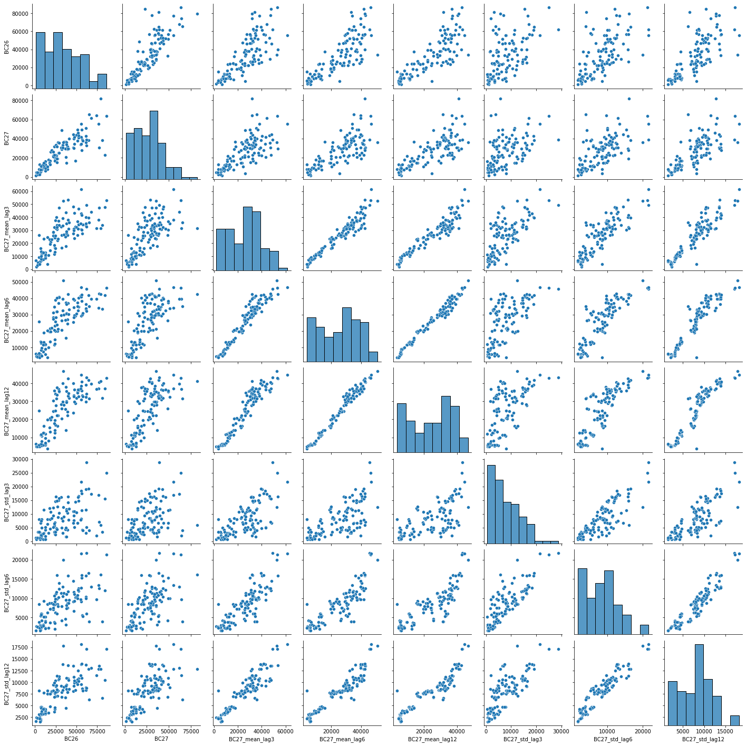
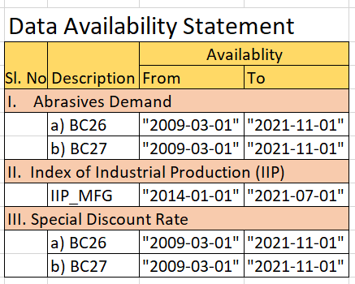
Dataset Details
Monthly Time-series data on
Abrasives Demand
Indices of Industrial Production
Monthly Special Discount Rate

Slide 13
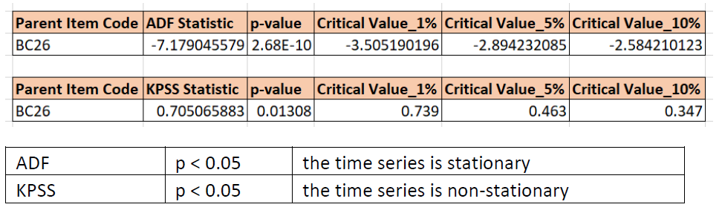
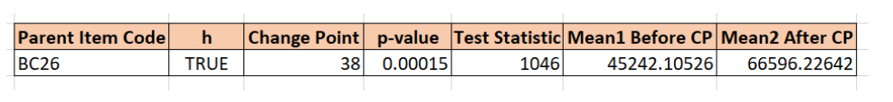
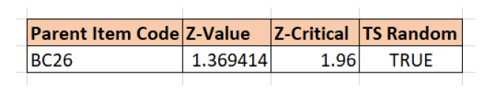
Data Quality Checks
Test for Stationarity
Test for Homogeneity
Test for Randomness

Slide 14
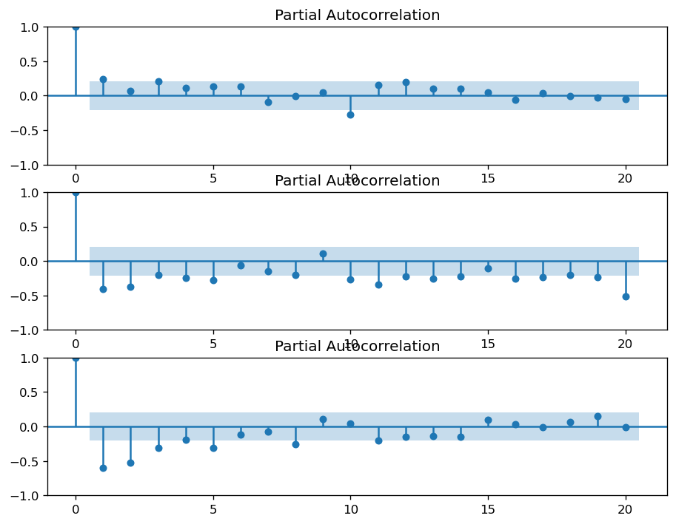
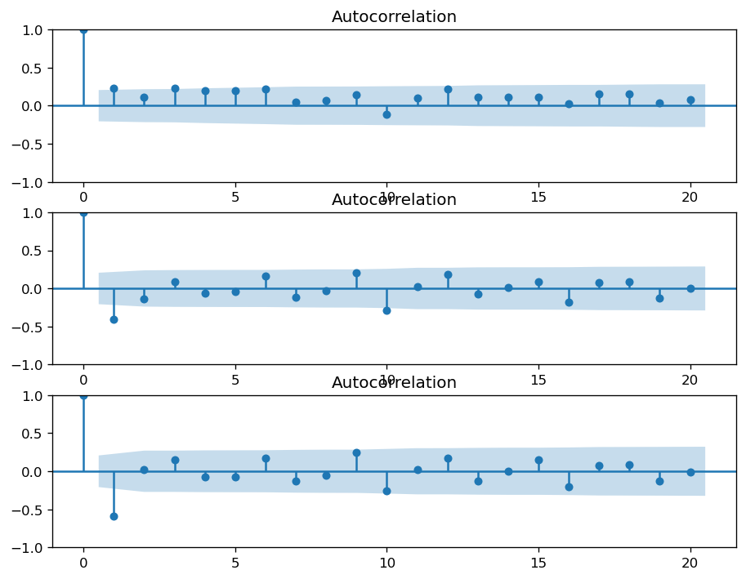
Selection of (p,d,q) for ARIMAX

Slide 15
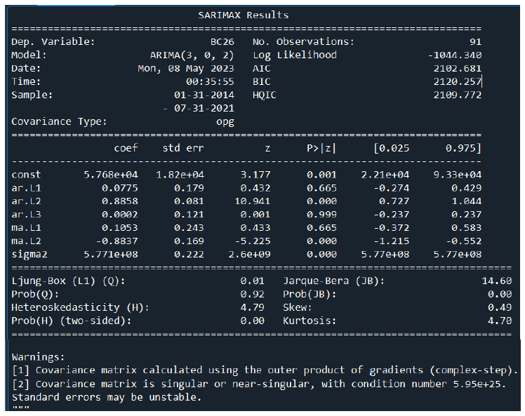
ARIMAX Model Parameters

Slide 16
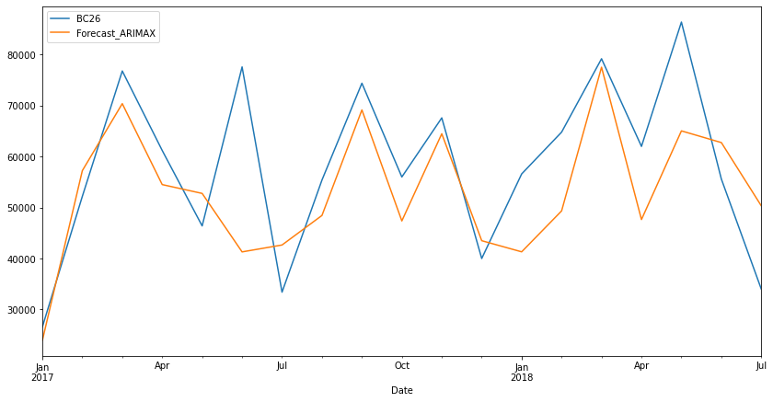
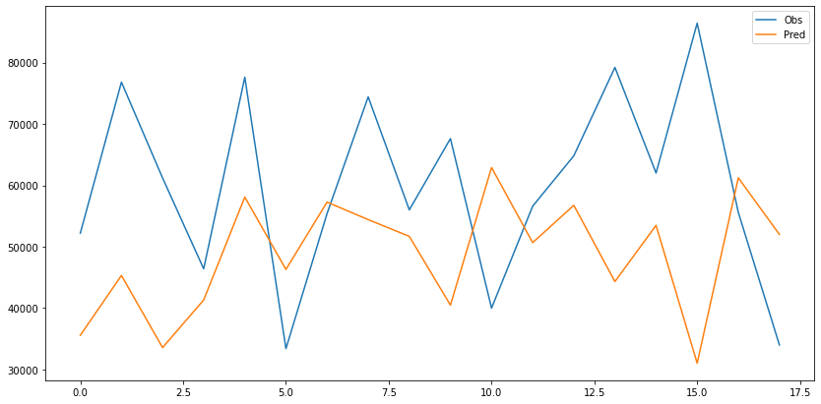
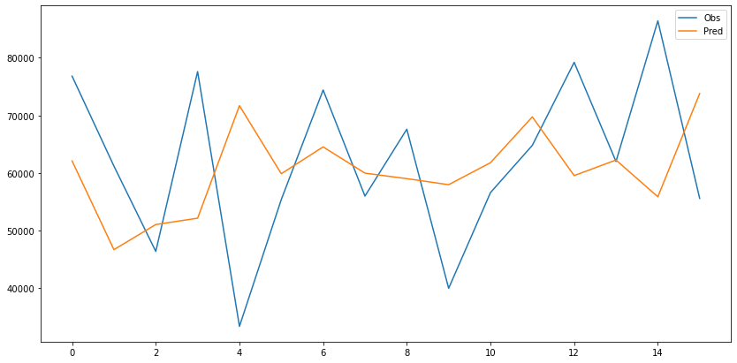
Results
Sl. No. | Model | MAPE
1 | ARIMAX | 17.75
2 | LSTM - Multivariate | 29.77
3 | LSTM - Univariate | 95.91
ARIMAX(3,0,2)(0,0,0)[0]
LSTM - MultiVariate
LSTM - Univariate

Slide 17
Conclusion & Work to be done
ARIMAX model performs better than LSTM models with an MAPE of 17.75
The external variables such as IIP and special discount rate do not have any correlation with demand as it does not have any specific annual pattern.

Slide 18
References
P. Pawar, S. Hatcher, L. Jololian and T. Anthony, "Demand Forecasting using Machine Learning," 2019 SoutheastCon, Huntsville, AL, USA, 2019, pp. 1-8, doi: 10.1109/SoutheastCon42311.2019.9020393.
M. E. Hoque, A. Thavaneswaran, S. S. Appadoo, R. K. Thulasiram and B. Banitalebi, "A Novel Dynamic Demand Forecasting Model for Resilient Supply Chains using Machine Learning," 2021 IEEE 45th Annual Computers, Software, and Applications Conference (COMPSAC), Madrid, Spain, 2021, pp. 218-227, doi: 10.1109/COMPSAC51774.2021.00040.
K. Wanchoo, "Retail Demand Forecasting: a Comparison between Deep Neural Network and Gradient Boosting Method for Univariate Time Series," 2019 IEEE 5th International Conference for Convergence in Technology (I2CT), Bombay, India, 2019, pp. 1-5, doi: 10.1109/I2CT45611.2019.9033651.
Bontempi, G., Taieb, S. and Borgne, Y. (2013). Machine Learning Strategies for Time Series Forecasting. Brussels, Belgium: SpringerVerlag. Available at: https://www.academia.edu/20245534/Machine_Learning_Strategies_for_Time_Series_Forecasting.
Bandar, K., Shi, P., Bergmeir, C., Hewamalage, H., Tran, Q. and Seaman, B. (n.d.). San Bruno, USA. Available at: https://www.academia.edu/38165760/Sales_Demand_Forecast_in_Ecommerce_using_a_Long_ShortTerm_Memory_Neural_Network_Methodology.
S. Mehrmolaei and M. R. Keyvanpour, "Time series forecasting using improved ARIMA," 2016 Artificial Intelligence and Robotics (IRANOPEN), Qazvin, Iran, 2016, pp. 92-97, doi: 10.1109/RIOS.2016.7529496.
S. Siami-Namini, N. Tavakoli and A. Siami Namin, "A Comparison of ARIMA and LSTM in Forecasting Time Series," 2018 17th IEEE International Conference on Machine Learning and Applications (ICMLA), Orlando, FL, USA, 2018, pp. 1394-1401, doi: 10.1109/ICMLA.2018.00227.

Slide 19
Thank you !

